Slide 1
Introduction to Computer Systems
Lecture 14
Great Ideas in Computer Systems aka. Semester Review
Wei Xu
Note: Some slides and/or pictures in the following are adapted from slides ©2005 Silberschatz, Galvin, and Gagne. Slides courtesy of Anthony D. Joseph, John Kubiatowicz, AJ Shankar, George Necula, Alex Aiken, Eric Brewer, Ras Bodik, Ion Stoica, Doug Tygar, David Wagner, and John Canny .

Slide 2
Final Administrivia
Final Exam
  Jun 16 ^{th} (Tuesday) 19:00-21:00
  Even student # -> 计科楼-3311
  Odd student # -> 计科楼-3417
  Covers the entire semester, covers very basic concepts
  2 cheat sheets allowed
  Other rules same as the midterm
Project 3 Extended
  Sunday 6/21 at 11:59pm
  【If you are graduating, deadline is 6/18 Thursday】
  No further extension, any late submission receives a 0
You need to return the Raspberry Pi’s to your TAs
  Lost / stolen? Report to the TAs now!
  Without that you will receive an “F” for the course

Slide 3
If you do not know what the following examples are about, you will need a good review before the final
Seriously..

Slide 4
Fundamental challenges in systems

Slide 5
Everything should be made as simple as possible, but no simpler. (A. Einstein)
An engineer is a man who can do for a dime what any fool can do for a dollar. (Anonymous)
Perfection is reached not when there is no longer anything to add, but when there is no longer anything to take away. (A. Saint-Exupery)

Slide 6

Challenges
Hardware limitations
  Power wall: cannot make CPU infinitely fast
  Memory wall: memory bandwidth / latency
  I/O much slower
    Capacity vs. cost vs. speed
    (Reliability vs. cost)
  Heterogeneity
    Portable to many systems / Interoperability
Workload demands
  Generality: Variety of workload / requirements
    Key question: What do you want?
    “do the right thing” vs. “do the thing right”
  (Scalability incrementally)
  Stupid developers / users
  (Malicious users)
  (Unpredictable)
Hardware
Demand
Systems

Slide 7
Memory Wall

Slide 8
Memory Wall
I/O much slower

Slide 9
Capacity vs. Cost

Slide 10
Capacity vs. Cost

Slide 11
Heterogeneity

Slide 12
Multiple Goals

Slide 13
Varying workload

Slide 14
Variety of workloads

Slide 15
Four threads cross the entire course

Slide 16
Thread 1: Cache Answers
Store the result of expensive work and reuse it instead of recomputing — the course's most central speed principle.
L1 Locality principle — the memory hierarchy and speed/capacity trade-off
L2 Registers — the top-level caching optimization
L3 Processor caches — blocks, associativity, the 3 Cs, replacement/write policies
L8 TLB & virtual memory — caching page-table entries; memory as a cache for disk
L9 Disk caching — exploiting access locality
L10 Buffer cache — caching disk blocks to speed up the read path
L11 / L13 DNS (with TTL) and distributed file-system caching

Slide 17
Thread 2: Keep Secrets — Abstraction & Virtualization
Separate the implementation from its clients through interfaces, indirection, and virtualization — the course's main functionality thread.
L1 Abstraction and the chain of representation (the "master illusionist")
L4 The process illusion — a private CPU and private memory
L8 Virtual memory — virtual vs. physical addresses hide the physical layout
L10 File systems — "named, durable objects" built on top of blocks
L11 Layering — connecting different network technology
L11 RPC — stubs and marshalling hide the network
L13 Single-system image — middleware and transparent remote files

Slide 18
Thread 3: The Fault-Tolerance Trio
The recurring theme of the concurrency and distributed-systems lectures: protection, atomicity, and end-to-end reliability.
Safety first- Protection & redundancy
L1 failure at scale
L4 user/kernel modes
L10 ACLs/capabilities/TCB
L13 distributed challenges
Make actions atomic- Atomicity & synchronization
L2 atomic instructions
L6 semaphores/monitors
L7 lock implementation
L13 stateless restart / idempotence
End-to-end- Push reliability to the application
L11 the end-to-end argument & TCP,
L13 where to resolve conflicts (ACID vs. BASE)

Slide 19
Thread 4: Handle Normal vs. Worst Case Separately
Make the common path fast and keep the rare path correct and bounded — a pattern hardware and operating systems use again and again.
Cache hit / page fault (L3, L8)
Hits are fast in hardware;
faults are the rare slow path, trapped into the OS
Polling / interrupts (L9)
Poll high-rate devices;
interrupt on rare events to avoid busy-spinning
Copy-on-write (L8)
Share read-only pages normally; split and copy only on an actual write

Slide 20
Interface: abstraction

Slide 21
The key interfaces in systems?
ISA
Programming Languages (Compilers)
Process and threads
System calls
I/O primitives (memory map, DMA)
Virtual Memory
File Systems
Network stack (interfaces in layer 2, 3, 4)
RPC
Databases -> SQL

Slide 22
Design principles for a good interface
Functionality / flexibility / portability / easy to use
  Do one thing well
  Use a good idea again, but do not generalize
  Stay stable
Performance
  Static analysis
  Dynamic translation (i.e. indirection)
  Asynchronous (background) tasks
Reliability
  Log updates
  Atomic operations

Slide 23
Interface
Functionality / design

Slide 24
Heterogeneity
Do one thing well
Keep Stable

Slide 25
Great design of the Unix shell
Building very basic tools
  Do one (or more) thing, and do it well
Connecting these tools into a powerful and customizable system
Need an programming language!
  Scripts
  Connects output of one command to the next
Idea
  Interpreted language
  Everything originally is a string + list, then interpret
    Command output etc.
  Naturally define inter-process communications
  The designer never thought of … It is perfect for AI !
The Bourne Again Shell (bash)
Heterogeneity
Do one thing well
Keep Stable

Slide 26
Five Layers Summary
Heterogeneity
Interoperability
Do one thing well
Keep Stable
Lower three layers implemented everywhere
Top two layers implemented only at hosts
Logically, layers interacts with peer’s corresponding layer
Application
Application
Transport
Transport
Network
Network
Network
Datalink
Datalink
Datalink
Physical
Physical
Physical
Host A
Router
Host B

Slide 27
Heterogeneity
Easy to use
Static Analysis

Slide 28
Heterogeneity
Portability
Static Analysis

Slide 29
Heterogeneity
Portability
Do one thing well
Keep Stable

Slide 30
The Internet Hourglass
Heterogeneity
Interoperability
Do one thing well
Keep Stable
SMTP
HTTP
DNS
NTP
Applications
TCP
UDP
Transport
Waist
IP
Data Link
Ethernet
SONET
802.11
Physical
Copper
Fiber
Radio
The Hourglass Model
There is just one network-layer protocol, IP
The “narrow waist” facilitates interoperability
Notes:
It’s like everyone speaks the same language.

Slide 31
Heterogeneity
Portability
Do one thing well

Slide 32
Motivation for Monitors and Condition Variables
Do one thing well
Semaphores are a huge step up; just think of trying to do the bounded buffer with only loads and stores
Problem is that semaphores are dual purpose:
  They are used for both mutex and scheduling constraints
  You hold the lock (mutex) even if you block on scheduling constraints
  Example: the fact that flipping of P’s in bounded buffer gives deadlock is not immediately obvious. How do you prove correctness to someone?
Notes:
2 types of constraints:
Mutual exclusions
Scheduling constraints

Slide 33
Interface
Implementation / performance

Slide 34
Heterogeneity
Portability
Dynamic translation
Asynchronous / Background

Slide 35
Portability
Easy to use
Human errors
Dynamic translation

Slide 36
Portability
Dynamic translation (naming)

Slide 37
Portability
Performance
Dynamic translation

Slide 38
Performance
I/O too slow
Asynchronous
Parallelism / batch

Slide 39
Performance
Asynchronous

Slide 40
Performance: I/O too slow
Correctness
Asynchronous

Slide 41
Interface
Reliability

Slide 42
Atomic Operations
Need a way to understand
Concurrent operations
To understand a concurrent program, we need to know what the underlying atomic operations are!
Atomic Operation: an operation that always runs to completion or not at all
  It is indivisible: it cannot be stopped in the middle and state cannot be modified by someone else in the middle
  Fundamental building block – if no atomic operations, then have no way for threads to work together
On most machines, memory references and assignments (i.e. loads and stores) of words are atomic
Many instructions are not atomic
  Double-precision floating point store often not atomic
  VAX and IBM 360 had an instruction to copy a whole array

Slide 43
The big picture of synchronization
Write correct concurrent code
Atomic Operations
Programs
Shared Programs
Higher-level
API
Locks Semaphores Monitors Send/Receive
Hardware
Load/Store Disable Ints Test&Set Comp&Swap
We are going to implement various higher-level synchronization primitives using atomic operations
  Everything is pretty painful if only atomic primitives are load and store
  Need to provide primitives useful at user-level

Slide 44
Need a ground for atomicity
Hardware Atomic Ops

Slide 45
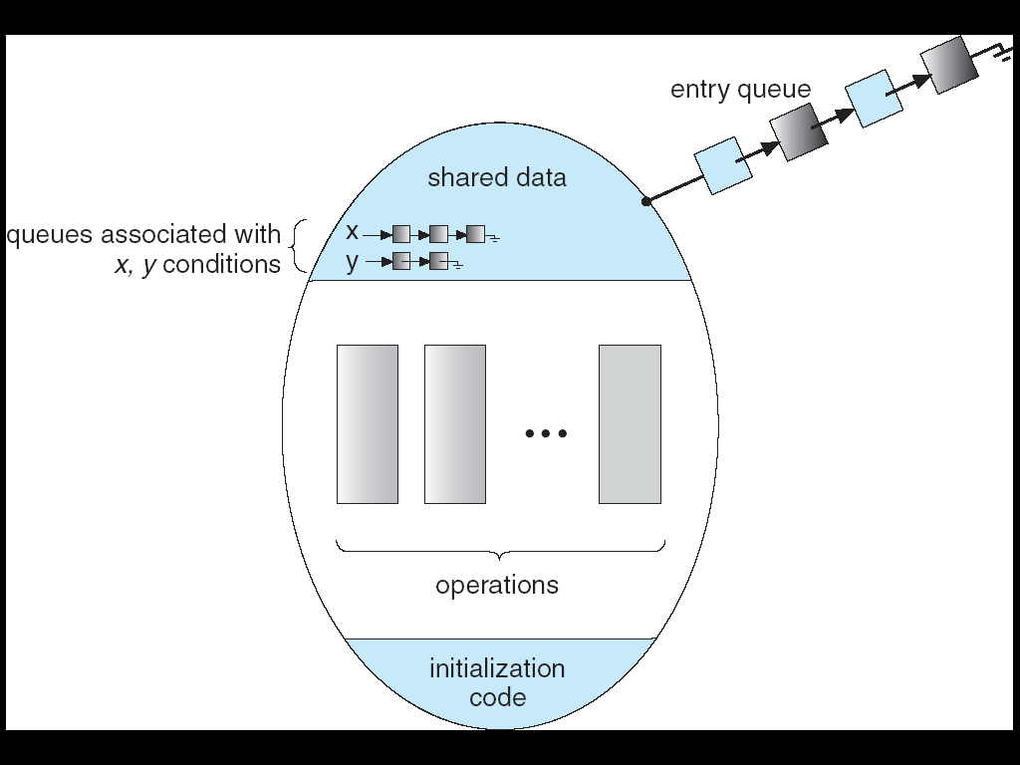
Monitor with Condition Variables
Write correct concurrent code
Atomic Operations
Lock: the lock provides mutual exclusion to shared data
  Always acquire before accessing shared data structure
  Always release after finishing with shared data
  Lock initially free
Condition Variable: a queue of threads waiting for something inside a critical section
  Key idea: make it possible to go to sleep inside critical section by atomically releasing lock at time we go to sleep

Slide 46
Java Language High-level Synchronization
Write correct concurrent code
Atomic Operations
public class SynchronizedQueue {
public LinkedList<Integer> q = new LinkedList<Integer>();
public synchronized void enqueue (int item) {
q.add(item);
notify();
}
public synchronized int dequeue () {
try {
while (q.size() == 0) {
wait();
}
return q.removeFirst();
} catch (InterruptedException e) {
return 0;
}
}
}
Notes:
Synchronized is like synchronized(this) { }

Slide 47
The ACID properties of Transactions
Write persistent storage is difficult
Atomic Operations
Atomicity: all actions in the transaction happen, or none happen
Consistency: transactions maintain data integrity, e.g.,
  Balance cannot be negative
  Cannot reschedule meeting on February 30
Isolation: execution of one transaction is isolated from that of all others; no problems from concurrency
Durability: if a transaction commits, its effects persist despite crashes

Slide 48
Read/Writer Lock
How to implement atomicity?
Building higher level atomic operations from lower level ones
Reader() {
// check into system
lock.Acquire();
while ((AW + WW) > 0) {
WR++;
okToRead.wait(&lock);
WR--;
}
AR++;
lock.release();
// read-only access
AccessDbase(ReadOnly);
// check out of system
lock.Acquire();
AR--;
if (AR == 0 && WW > 0)
okToWrite.signal();
lock.release();
}
Writer() {
// check into system
lock.Acquire();
while ((AW + AR) > 0) {
WW++;
okToWrite.wait(&lock);
WW--;
}
AW++;
lock.release();
// read/write access
AccessDbase(ReadWrite);
// check out of system
lock.Acquire();
AW--;
if (WW > 0){
okToWrite.signal();
} else if (WR > 0) {
okToRead.broadcast();
}
lock.release();
}

Slide 49
Ex: Creating a file (as a transaction)
How to implement atomicity?
Log Updates
Find free data block(s)
Find free inode entry
Find dirent insertion point
---------------------------------------------------------
[log] Write map (used)
[log] Write inode entry to point to block(s)
[log] Write dirent to point to inode
Free space map
Data blocks
…
Inode table
Directory
entries
tail
head
done
pending
start
commit
Log: in non-volatile storage (Flash or on Disk)

Slide 50
Two-Phase Locking (2PL)
Concurrencies are hard
Transactions
1) Each transaction must obtain:
  S (shared) or X (exclusive) lock on data before reading,
  X (exclusive) lock on data before writing
2) A transaction can not request additional locks once it releases any locks
Thus, each transaction has a “growing phase” followed by a “shrinking phase”
Lock Point!
Growing
Phase
Shrinking
Phase

Slide 51
Locality and caching

Slide 52
Caching Ideas
Why it works?
  Locality
  Cache performance models
Where to cache?
  The entire memory hierarchy
  CPU – VM – FS – Distributed FS
(What to cache?)
  (replacement policies)
Pitfalls in caching
  Cache invalidation (only the basics)
  Cache staleness / consistency – access semantics

Slide 53
Why does caching work?
Locality widely exists…

Slide 54
Need a way to quantify caching performance!
Performance Model

Slide 55
Caching memory transalation
Performance Model

Slide 56
Capacity vs. cost vs. speed
TLB

Slide 57
Capacity vs. cost vs. speed
I/O too slow
Virtual memory cache

Slide 58
Capacity vs. cost vs. speed
FS cache

Slide 59
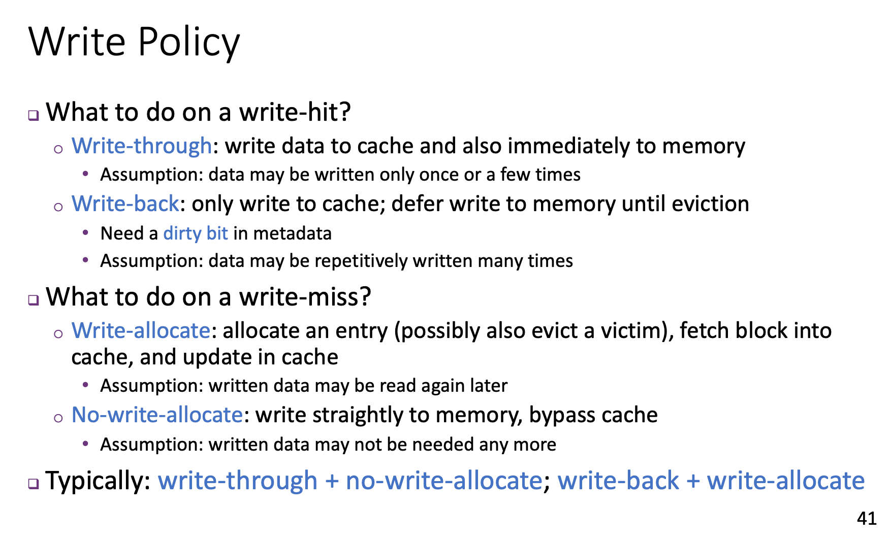
Challenges in Caching
Write policy may lead to inconsistency

Slide 60
There are only two hard things in Computer Science: cache invalidation and naming things.
-- Phil Karlton.
The third one?
Off-by-one error

Slide 61


Use Caching to Reduce Network Load
Use cache leads to extra issues
Consistency / invalidation
read(f1)
→V1
cache
Read (RPC)
read(f1)→V1
read(f1)→V1
F1:V1
Return (Data)
read(f1)→V1
Client
Write (RPC)
Server
cache
F1:V1
F1:V2
ACK
cache
write(f1)
→OK
F1:V2
read(f1)→V2
Client
Advantage: if open/read/write/close can be done locally, don’t need to do any network traffic…fast!
Problems:
  Cache consistency!
    Client caches not consistent with server/each other
    Who cached what?
  Failure:
    Client caches have data not committed at server

Slide 62
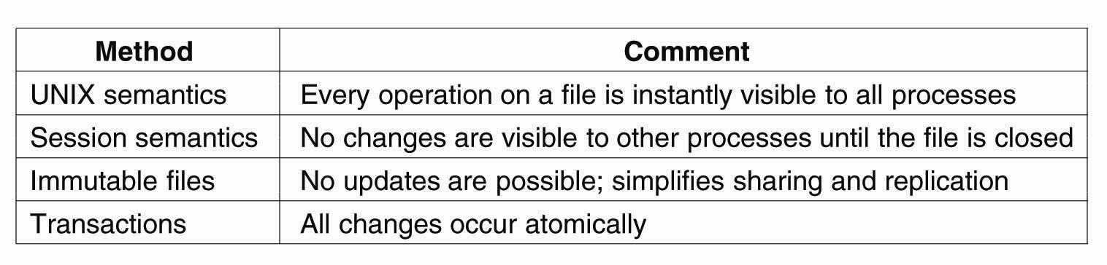
Popular Semantics of File Sharing
Can we use non-perfect caching?
Definition of what is “correct” caching?

Slide 63
Performance:
Batching and parallelism

Slide 64
Parallelism makes modern computer systems work
Parallelism is at different levels
Architecture level
  Pipelines
  SIMD
  Multi-core -> GPUs
  DMA
Storage
  SSDs
  RAID
OS level
  Threads
  Processes
  I/O – CPU
  Transactions
Networking
  Sending multiple packets without ACK
Human Papalism
  Git
When can we use parallelism?
  Can we do it automatically?
What are potential problems?
  Managing shared resources
  Deadlocks
  Concurrency problems

Slide 65
Frequency - Utilization
Pipelines

Slide 66
Power Wall
Parallelism at different levels
Memory Wall

Slide 67
Power Wall
SIMD

Slide 68
Storage Speed
Storage parallelism

Slide 69
Four requirements for Deadlock
Issues created by concurrency
Issues: deadlocks
Mutual exclusion
  Only one thread at a time can use a resource
Hold and wait
  Thread holding at least one resource is waiting to acquire additional resources held by other threads
No preemption
  Resources are released only voluntarily by the thread holding the resource, after thread is finished with it
Circular wait
  There exists a set {T₁, …, T_{n}} of waiting threads
    T₁ is waiting for a resource that is held by T₂
    T₂ is waiting for a resource that is held by T₃
    …
    T_{n} is waiting for a resource that is held by T₁

Slide 70
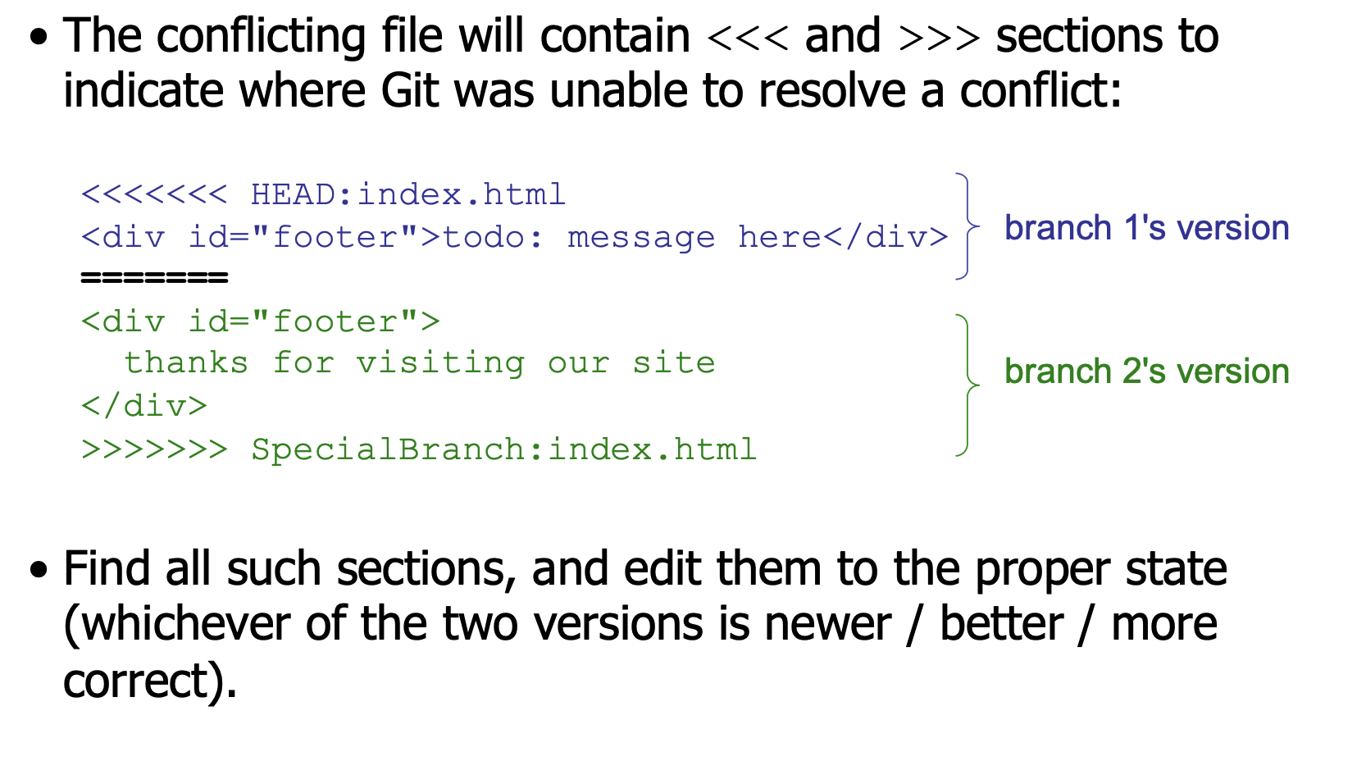
Git Merging Conflict
Issues created by concurrency
Human parallelism
Solving conflicts

Slide 71
Interfaces to Parallelism
Interface to CPU parallelsm
  SIMD instructions
  Compiler auto-optimization (Static analysis)
  Processes
  Threads
Interfaces for I/O parallelism
  Transparent (hardware)
  Mmap
  Buffer cache / write back
  Transactions
  Interrupts

Slide 72
Time sharing / multiplexing
Different goal from papalism – you only have a single resource, but you pretend to have more than one for different users.

Slide 73
I/O too slow
Processes

Slide 74
Multiple Processes / Threads
Collaborate on a Task
Modularity
(Maybe performance)
Processes as units for protection and resource allocation
Proc 1
Proc 2
Proc 3
Need Communication mechanism:
  Separate address spaces isolates processes
  Shared-Memory Mapping
    Accomplished by mapping addresses to common DRAM
    Read and Write through memory
  Message Passing
    send() and receive() messages
    Works across network
Notes:
Collaboration allows faults to propagate…

Slide 75
With in a process, still need more parallelism
Threads as modules for execution

Slide 76





Packet Switching — Statistical Multiplexing
Capacity vs. Cost
Sharing a network link
Packets
Swtiches arbitrate between inputs
Can send from any input that’s ready
  Links never idle when there is traffic to send
  Efficiency

Slide 77
Concurrent Execution & Transactions
I/O too slow
Concurrent Transactions
Concurrent execution essential for good performance
  Disk slow, so need to keep the CPU busy by working on several user programs concurrently
DBMS only concerned about what data is read/written from/to the database
  Not concerned about other operations performed by program on data
Transaction – DBMS’s abstract view of a user program, i.e., a sequence of reads and writes.
Locks are an important part of concurrency control.
Notes:
Only related to database, not computation on the data loaded from db.

Slide 78
Two-Phase Locking (2PL)
How do you increase level of sharing?
Only get locks when you need them!
1) Each transaction must obtain:
  S (shared) or X (exclusive) lock on data before reading,
  X (exclusive) lock on data before writing
2) A transaction can not request additional locks once it releases any locks
Thus, each transaction has a “growing phase” followed by a “shrinking phase”
Lock Point!
Growing
Phase
Shrinking
Phase

Slide 79
Four requirements for Deadlock
Get resources as you go improves sharing
But may create hold-and-wait con
Mutual exclusion
  Only one thread at a time can use a resource
Hold and wait
  Thread holding at least one resource is waiting to acquire additional resources held by other threads
No preemption
  Resources are released only voluntarily by the thread holding the resource, after thread is finished with it
Circular wait
  There exists a set {T₁, …, T_{n}} of waiting threads
    T₁ is waiting for a resource that is held by T₂
    T₂ is waiting for a resource that is held by T₃
    …
    T_{n} is waiting for a resource that is held by T₁

Slide 80
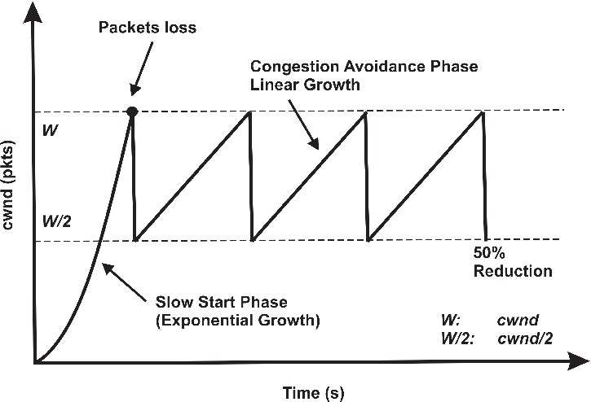
Intuitive TCP flow control
Fairness in Sharing / avoid congestion
Flow and congestion control
Retransmit lost packets
  Keep a sequence number on each packet
Figuring out the rate
  Slow start
    Start with very small sending rate, increase fast
    Until detect overflow (how?)
  Slowdown quickly, then increase slowly until overflow again
  AIMD = additive increment multiplicative decrement
Many details + optimizations in networking course

Slide 81
Indirection
(name resolution)

Slide 82
Sharing
Different protection
VM tricks

Slide 83
Different protection
Sharing files
FS Tricks

Slide 84
Protection
(against stupidness)

Slide 85
Users are stupid
Human concurrency
Solving conflicts

Slide 86
Users are stupid
VM for protection

Slide 87
Users are stupid
Background task

Slide 88
Users are stupid
Background tasks
Static Analysis

Slide 89
Separation of
Policy and mechanism

Slide 91
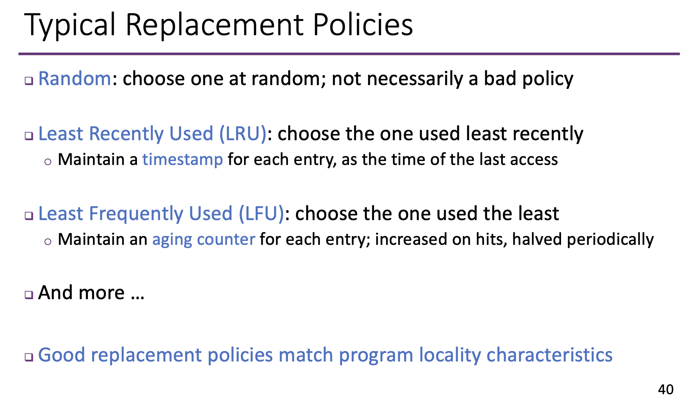

Slide 92
Data structures in systems

Slide 93
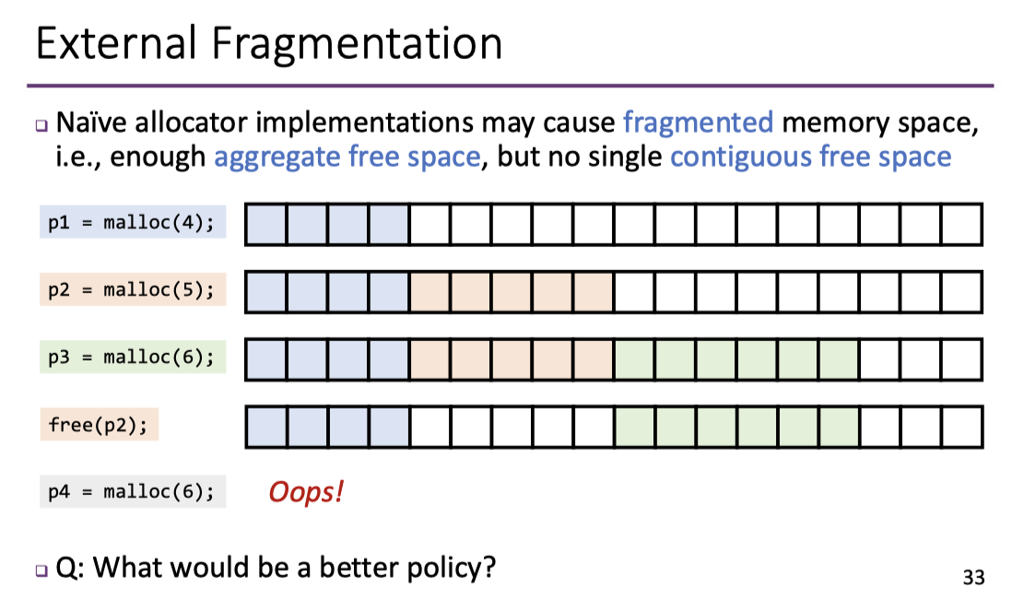
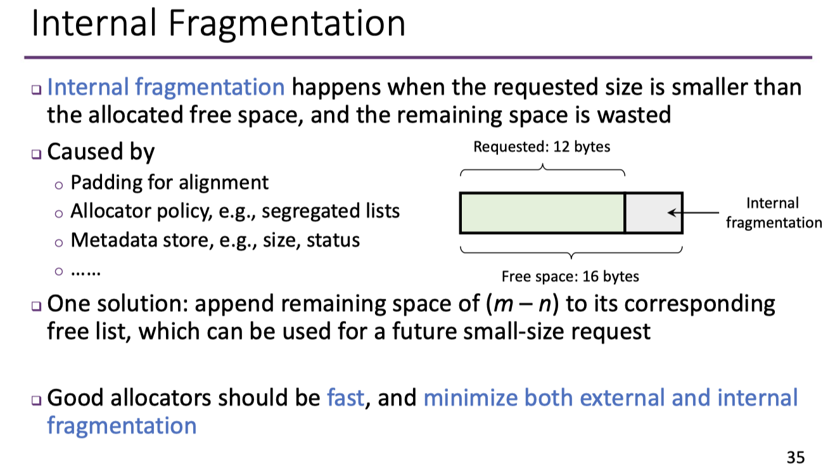
A chain of fixed sized blocks
Internal vs. External Fragmentation
Allocate in fixed sized blocks

Slide 94
Lookup speed vs. conflicts
Set associativity

Slide 95
Sparse allocation vs. continuous allocations
Multi-level page tables

Slide 96
Large files vs. small files
iNode

Slide 97
Reduce management overhead: indices
bitmap

Slide 98
Write-ahead logs
Reliable and Append Only Data Structure that Survives Crashes
Append only logs
Scan log, find start
Find matching commit
Redo it as usual
  Or just let it happen later
Free space map
Data blocks
…
Inode table
Directory
entries
tail
head
done
pending
start
commit
Log: in non-volatile storage (Flash or on Disk)

Slide 99
Final words …

Slide 100
Systems courses
General Systems
  Computer architecture
  Compilers
  Operating systems
  Distributed systems
  Database management systems
  Computer networking
  Software engineering
  Cyber security
Specialized Systems
  Big data systems
  Deep learning systems
  Embedded systems / IoTs
  Real-time systems (cyber-physical systems)

Slide 101
Research / industry trend in systems
Faster
  Specialized accelerators (domain specific architecture)
Smaller
  Phones, IoTs, sensors
  Ubiquitous
Larger
  Data centers / Internet scale
  Greener: less energy, more green energy
More reliable and secure
  Trustless systems / blockchains
  Privacy preservation
Easier to use
  Automated / few code
  Easier to operate: AIOps
Integrate into other areas
  Industrial / aerospace / autonomous driving …
  Sys for ML

Slide 102
Systems Courses @ IIIS
Computer architecture
  Mingyu Gao
  Kaisheng Ma
Databases
  Huanchen Zhang
Distributed systems
  Wei Xu

Slide 103
Thank you for the semester
Good luck in your exams and projects
Hope to see you again in 1 or 2 years

